Slide 1
PARTNERSHIP
VISIBILITY GUIDELINES

Slide 2
2
DONOR RECOGNITION
THE IMPORTANCE OF VISIBILITY
A strong and consistent visual identity helps the public recognize, access and trust government-supported programs and services.
Notes:
Other reasons to ensure proper acknowledgement of funders:
It’s a reflection of:
the quality and significance of the initiative (project, organization, event, etc.)
the government thought it was important
your credibility
Capacity to raise funds, to understand administrative processes, and to collaborate.
It is an opportunity to say thank you and to cultivate the relationship with the donor
It maintains the visual integrity of your partners

Slide 3
3
COMMUNICATION TOOLS
PROMOTING YOUR INITIATIVES
Print materials
Flyers, posters, research reports
Press releases, newspaper articles
Others
Promotional items
Pens, bags, water bottles
Sticky notes, sweaters
Others
Digital tools
Social media, websites, videos, podcasts
Interviews (radio, television)
Others
Public events
Press conferences, speeches
Events, networking activities
Others
Notes:
A communication tool is a medium that makes it possible to promote projects/initiatives.
When an activity is made possible because of the support of a funder, acknowledgement of the latter is required.
Different guidelines may apply to the various media, all of which can be found on the government website www.piv.gouv.qc.ca.

Slide 4
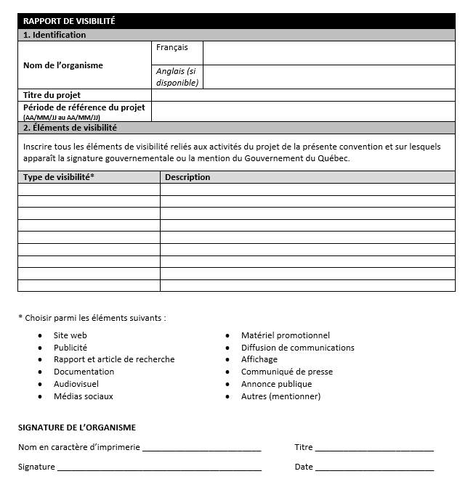
4
UNDERSTANDING YOUR OBLIGATIONS
REPORTING ON VISIBILITY
FINANCIAL SUPPORT AGREEMENT
6.2.11. Give the Ministère adequate visibility in relation to its financial participation. The Ministère reserves the right to require visibility elements to promote its financial participation. These visibility elements are listed in Annex 4. (courtesy translation)
ANNEX 4 is required for the 2nd, 4th, and 6th instalments
Notes:
Read your agreement (article 6.2.11 and Annex 4).
85% of what’s expected with regards to visibility is explicitly stated in your funding agreement.
The other 15% can be found on www.piv.gouv.qc.ca
If something is unclear, either ask your advisor or write to the address provided in your agreement: dcom@finances.gouv.qc.ca
Keep in mind:
Use of the government logo is consistent from one administration unit to another.
What differs from one unit to another is when to use the logo.
Guidelines for using government signatures are consistent across administrative units.
As per your agreement:
If you receive a grant under the Secrétariat program, you agree to:
acknowledge the participation of the Québec government as a financial partner in your promotional materials, advertising messages, website and public events, in accordance with the financial support agreement that provides the framework for your partnership;
keep in mind that mention of the contribution of the SRQEA or the Québec government is to be determined by the other departments, organizations or partners involved in financing the project;
give the Minister, or his or her representative if you wish to make a public announcement, the prerogative of announcing the grant, either by attending your event (press conference, ground-breaking ceremony, worksite visit, official inauguration, open house, etc.) or by issuing a press release.
You must contact the SRQEA within thirty (30) days prior to the desired date of the event to agree on the Minister's presence, as well as on a date and location.
mention the participation of SRQEA in your public announcement regarding financial assistance;
notify the SRQEA in advance of any public speeches you make about projects for which you have received funding, including press conferences, interviews, participation in round tables, etc.;
mention the participation of the SRQEA in all communications relating to the outcome of your organization, project or event.

Slide 5
UNDERSTANDING YOUR OBLIGATIONS
REPORTING ON VISIBILITY
ANNEX 4
All of the following provisions regarding the visibility of the SRQEA at events or activities are mandatory depending on the context outlined in the project.*
Honour the principle of fairness in visibility
Obtain the approval of the Direction des communications
Provide technical specifications for communication tools
Respect the prerogative of the Minister
Notes:
* By agreement with the organization, the SRQEA may reserve the right to not use certain provisions or to replace them as needed.
AS PER YOUR FUNDING AGREEMENT
In accordance with the provisions of article 6.2.11 of this Agreement, the organization undertakes to:
Honour the principle of fairness in the visibility offered to the SRQEA, in proportion to the size of its contribution relative to the total amount of the project and the contribution of other partners;
Obtain the approval of the Direction des communications of the Ministère des Finances for all visibility elements described in the annex and on which the government signature or the “Gouvernement du Québec” logo appears, within the timeframes provided and before public distribution of the documents;
Provide technical specifications for the document in question (advertising material, ministerial remarks, press releases, etc.) to the Direction des communications of the Ministère des Finances within the timeframes specified in the annex;
Respect the prerogative of the Minister to choose when and where the public announcement of the grant under this Agreement will take place. The organization will:
invite the Minister or his or her representative to hold a press conference;
obtain the Minister’s written authorization to make the public announcement concerning the grant provided by the Québec government. Without this written authorization, the organization cannot publicly announce the funding provided by the Québec government.

Slide 6
6
DONOR RECOGNITION
VISIBILITY GUIDELINES FOR THE QUÉBEC GOVERNMENT
The SRQEA wordmark should ideally be used with an acknowledgement statement.*
Administrative units must be written in French.
The Secretariat for relations with English-speaking Quebecers does not exist.
When spelled in full, the SRQEA should ideally appear on a single line.
Joint funding or communication from more than one administrative unit requires the Québec-drapeau wordmark.
With the financial support of:
‘’This initiative (or project or event) is supported (or supported in part) by the Secrétariat aux relations avec les Québécois d’expression anglaise.”
Cette initiative (ou projet ou événement) est soutenue (ou soutenue en partie) par le Secrétariat aux relations avec les Québécois d’expression anglaise.
ou
Notes:
If possible, clearly indicate the contribution of public funds to the implementation of the project. Here are examples of possible wording:
“This initiative is supported by the Secrétariat aux relations avec les Québécois d’expression anglaise.”
“This project was funded by the Secrétariat aux relations avec les Québécois d’expression anglaise/the Québec government.”
* no need to include wording with the full name of the SRQEA and the logo... or the name of the organization (if space does not allow for the signature).
ensure that the government signature is favourably positioned (never on the right) in all documents and communication tools, particularly on the website;
give the Québec government visibility equivalent to that given to any other partner at the same level.

Slide 7
7
DONOR RECOGNITION
VISIBILITY GUIDELINES FOR THE QUÉBEC GOVERNMENT
No alterations to the wordmark: use only the files provided by the Secrétariat.
Respect the protection zone and minimal size requirements.
5.5 mm/flag height
Refrain from using the wordmark in the bottom right-hand corner.
The SRQEA wordmark should never be used on promotional items (e.g., water bottles).
Once approved by the Secrétariat, a template can be reused without obtaining a second approval.*
Notes:
Point 1
The elements of the wordmark are not dissociable.
Do not:
invert the symbol
change the official colours
rotate, stretch
modify the font
use on a low contrast background, etc., otherwise use the black or inverted logo (white)
Point 2
To ensure the readability of the wordmark, the flag (of the SRQEA logo or the Québec-drapeau) should never be smaller than 5.5 mm
The size of the logo (i.e., the space it occupies) should reflect the size of the contribution
If the financial contribution is equal to that of another partner, the wordmark of the SRQEA should be comparable in size.
Point 4
To avoid confusion: official communications and/or initiatives of the Québec government typically place the wordmark in the bottom right-hand corner.
Point 5
* Conditions apply:
If the initiative is funded by a second administrative unit, in addition to the SRQEA, the logo would need to change
If the background colour changes in a way that changes which logo format is required
Etc.

Slide 8
8
WHAT NOT TO DO: EXAMPLES
1.
2.
4.
3.
5.
Notes:
1. Insufficient quality of the logo.
2. The logo must be used without white background and the acknowledgement statement should either be removed or slightly tweaked
This event was made possible with support from:
3. Wordmark is too small
4. When the logo is used, the name of the SRQEA should not be included in the acknowledgement statement
5. Protection zone is not respected.

Slide 9
9
YOUR POINT OF CONTACT
All communications are reviewed on a case-by-case basis by the Direction des communications
(dcom@finances.gouv.qc.ca)
Communications should be sent for review at least 10 days before distribution
Copy your advisor
All visibility guidelines can be found at www.piv.gouv.qc.ca
Notes:
The SRQEA reserves the right to review the visibility given to its visual signature and that of the Québec government.
You also agree to:
obtain approval for all visibility elements that emphasize the SRQEA partnership, and provide the SRQEA with a minimum of 10 days to do so.

Slide 10
QUESTIONS?

